Slide 1
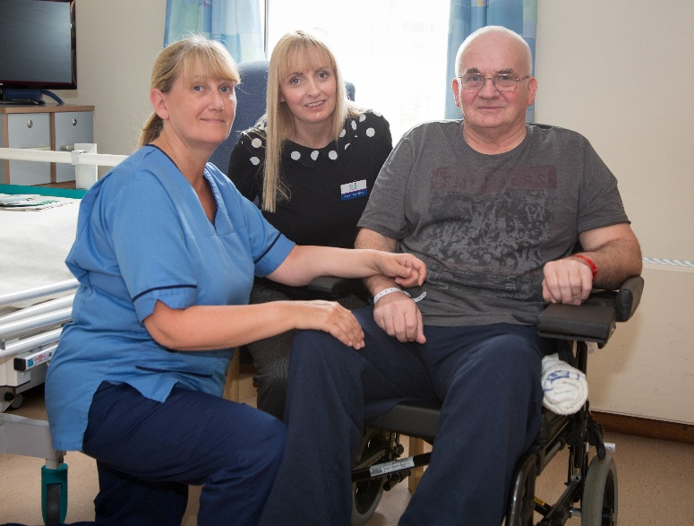
Top ten nursing research priorities
1. What are the best ways to manage and/or prevent fatigue?
2. What are the best ways to improve cognition after stroke?
3. What are the best ways to manage urinary and faecal incontinence?
4. What are the best ways to manage altered mood and emotion after stroke?
5. What are the best ways to promote self-management and self-help after stroke?
6. What are the best ways of helping stroke survivors and their families come to terms with uncertainty of prognosis and the long-term consequences of stroke?
7. Can a goal setting approach help recovery after stroke?
8. What is the impact of thrombolysis on emotion, cognition and communication?
LIFE after STROKE
9. Is a “young stroke environment” better than other stroke rehabilitation environments at improving recovery of young people after stroke?
10. What is the optimal amount and intensity of therapy provided by nurses for patients with stroke?

Slide 2
Please contact us if you wish further support with your research question/s
Send to: A Rowat
SSNF Research Action Group
4b44, Sighthill Campus
Edinburgh Napier University
Sighthill Court
Edinburgh
EH11 4BN
Email: a.rowat@napier.ac.uk
Tel: 0131 455 5670
Research questions (or numbers) I/we wish to investigate include:
Contact details and email address:

